Slide 1



Women & Children’s Services
Tampa General Hospital
Pamela G. Sanders, MSN, RNC-NIC, CENP
Vice-President

Slide 2
Women’s Services
2013 Stats/month
450 Deliveries
900 Triage visits
145 C-sections
350 non-OR procedures
Labor & Delivery
  21 LDR Suites
  6 Triage Rooms
  4 ORs
  6 Recovery Bays
62 AntePartum/Post Partum Rooms

Slide 3
Women’s Specialty Services
IVF Program
Maternal Fetal Medicine Program
Designated Regional Perinatal Intensive Care Center
Lactation Consultant Program
Quality Collaborative:
  Best Fed Beginnings Collaborative: Baby Friendly Hospital Initiative
  Florida Perinatal Quality Collaborative: Obstetric Hemorrhage Initiative

Slide 4

Labor & Delivery Suite

Slide 5
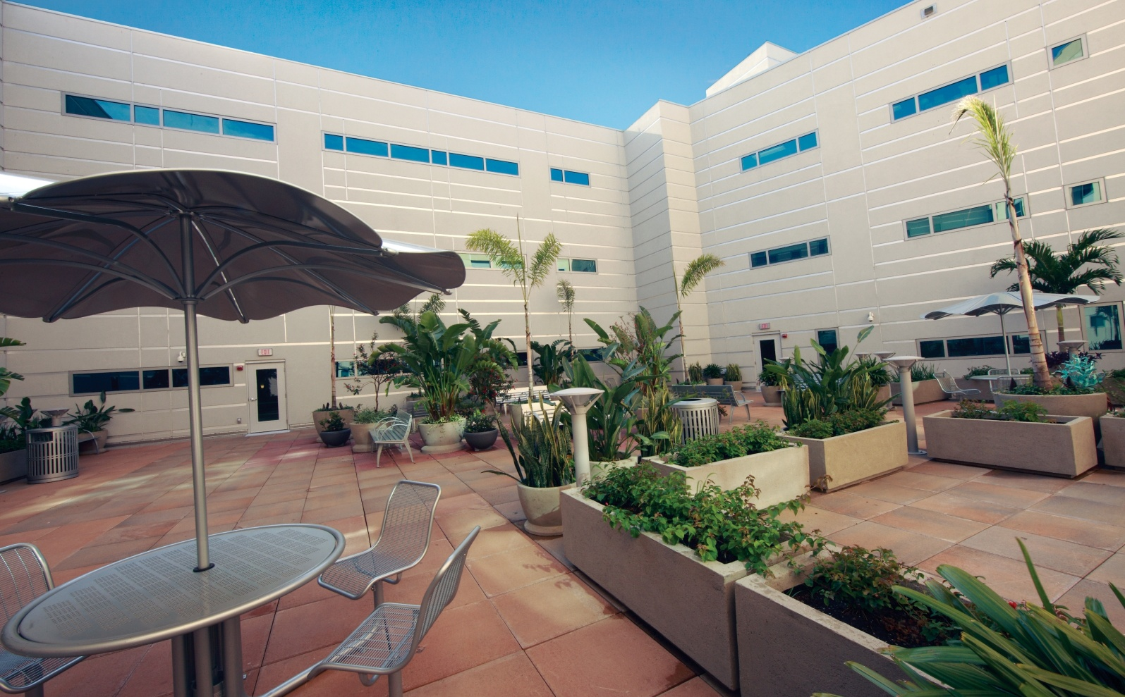
Women’s Center Garden

Slide 6
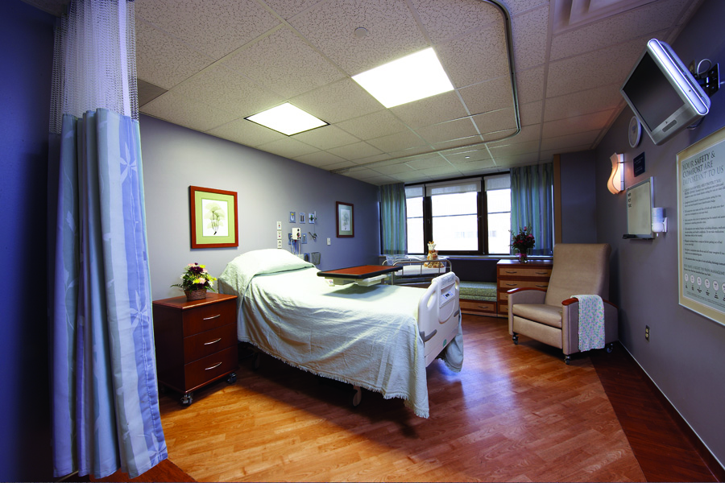
Ante-partum/Postpartum Unit

Slide 7

The Children’s Medical Center

Slide 8
Pediatric Services
2013 Volumes
NICU-50 ADC
PICU-5 ADC
Pedi M/S-25 ADC
Pedi ED-1,200 visits/month
Pedi Rehab-8
Pedi Dialysis-138 treatments/month
PDH-130 procedures /month
Pedi Surgery cases-180/month
82 bed NICU
12 bed Transition Nursery
9 bed PICU
43 bed Pediatric Medical/Surgical Unit
PDH
PHDU
Pediatric Emergency Department

Slide 9
Pediatrics Specialty Services
Pediatric Emergency & Trauma Program (only Level 1 designated Pediatric Trauma program in Florida-American College of Surgeons)
Pediatric Burn Program (ABA-ACS Verified)
Pediatric Rehabilitation Program (CARF Certified)
Pediatric Dialysis Program
Pediatric Kidney Transplant Program
Pediatric Day Hospital/Sedation program
Pediatric Metabolic Program (1 of 3 in the state)
Member of Children’s Oncology Group
Neonatal Transport program
Neonatal Neuro-protection Program
Neonatal ECMO Program
Neonatal Follow-up Program

Slide 10
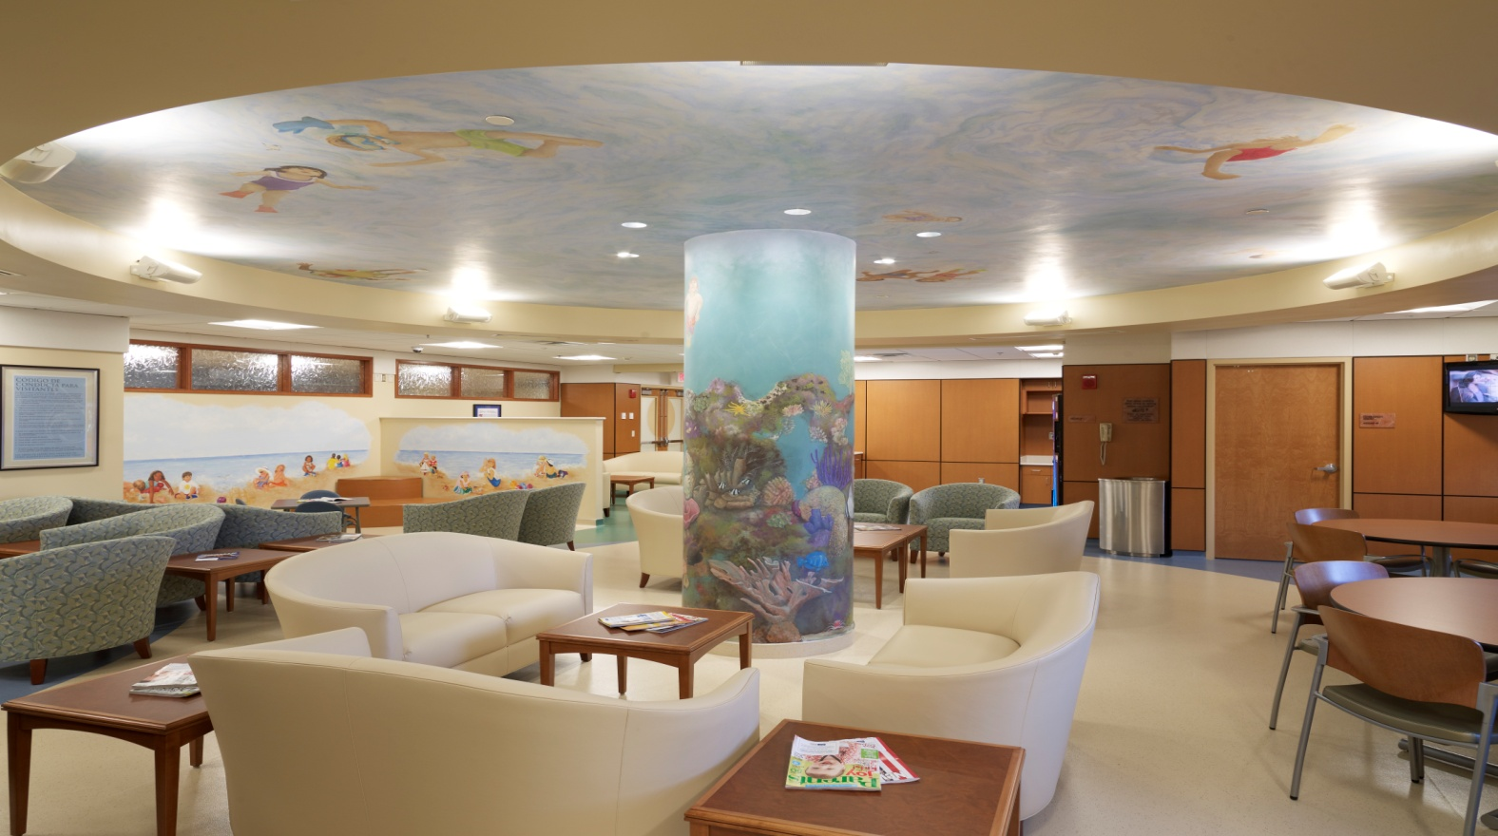
Jennifer Leigh Muma Neonatal Intensive Care Unit Family Learning Center

Slide 11
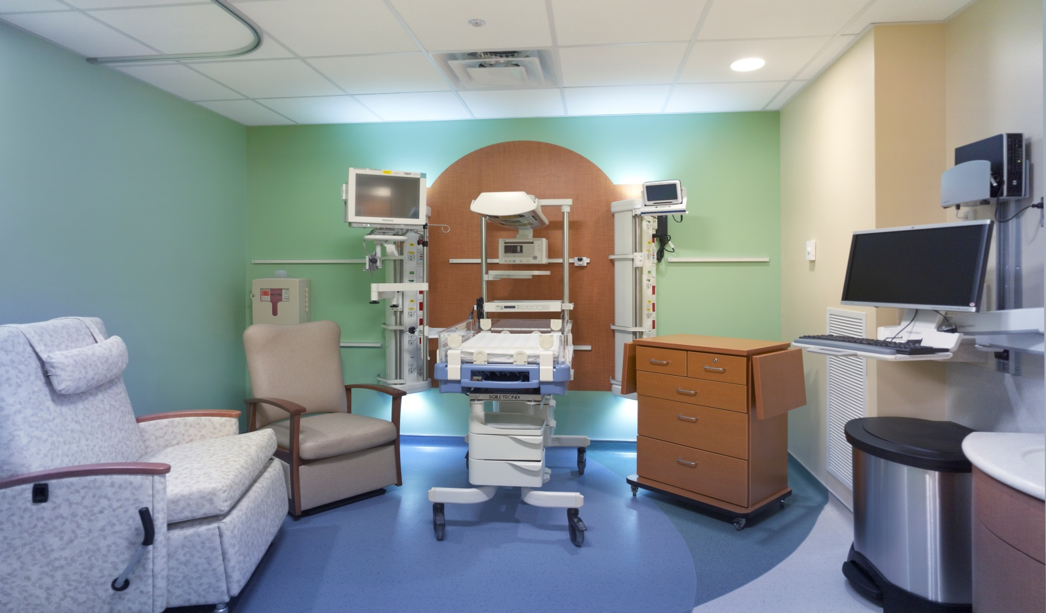
NICU Single Family Room

Slide 12
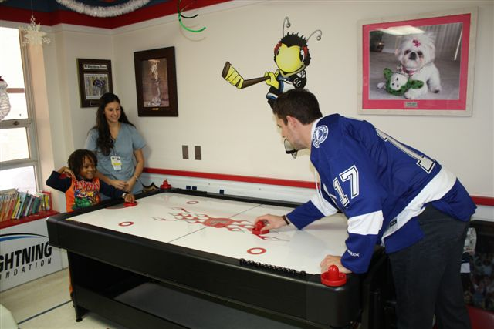
Lightning Play Room

